Slide 1
Data Warehousing Lifecycle
Overview

Slide 2
Data Warehousing Lifecycle
…..Can be viewed in many ways depending on the approach you are using….

Slide 3
Data Warehousing Lifecycle
Conceptual modeling:
System requirements,
data sources and
warehousing activities.
Logical design:
Data flow from sources
to DW, composition and
semantics of activities.
Application development:
DW interfaces, OLAP
and data mining tools.
DW construction:
Schema implementation,
data population and
warehouse tuning.

Slide 4

Data Warehouse Lifecycle
  Analysis
  Design
  Import data
  Install front-end tools
  Test and deploy

Slide 5
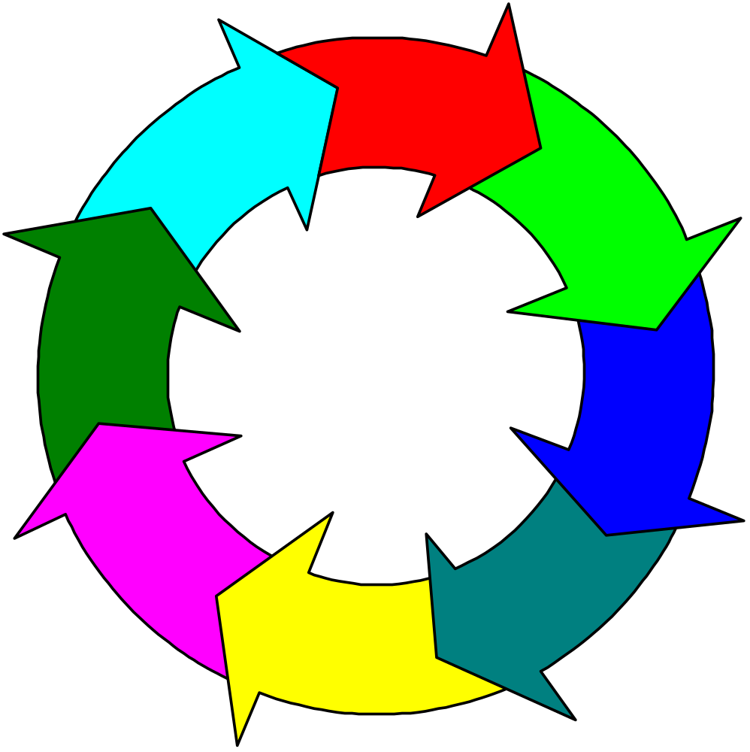
The data warehouse life cycle
Investigation
On-going data
administration
Analysis of current
environment
Implementation
Identify requirements
Development
Identify architecture
Data warehouse design

Slide 6
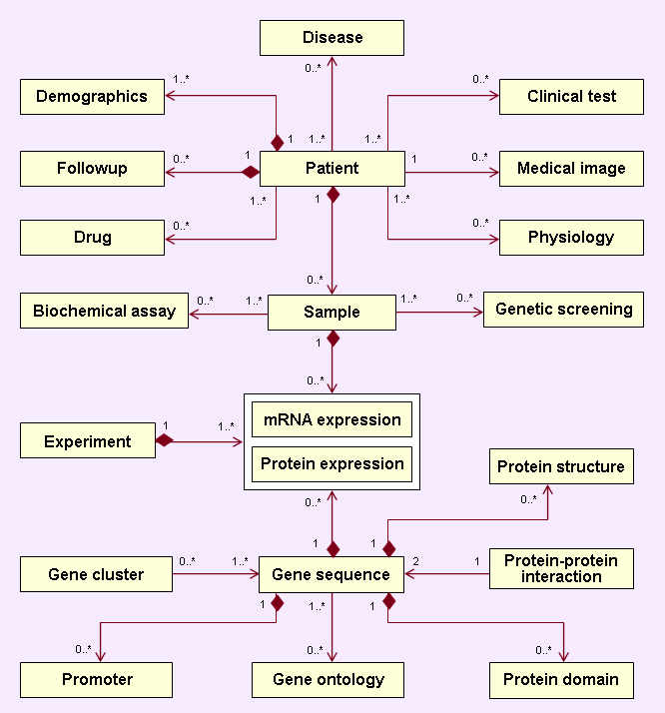
Example:
Biomedical Data Warehouse System Architecture
Data Sources
Data Integration
Data Warehouse
Unified Access
Data Mining
Clinical data and sample annotations
Ad hoc
queries
OLAP
Cluster
analysis
Mining gene
regulatory
networks
Interactome
prediction
Pathway
analysis
Gene functional annotations
Data extraction, trans-
formation, cleaning
& loading
Metadata capturing & integration
Data quality control
Refreshment
A standard interface for application tools
Object-oriented
Defining basic operators
for data access
Microarray
mRNA
expression
Proteomics protein
expression
Promoter
sequences
and motifs
Protein domains & interactome

Slide 7
Recall…Data Warehousing concepts

Slide 8
What Is a Data Warehouse?
Definition: A data warehouse is the data repository of an enterprise. It is generally used for research and decision support.
By comparison: an OLTP (on-line transaction processor) or operational system is used to deal with the everyday running of one aspect of an enterprise.
OLTP systems are usually designed independently of each other and it is difficult for them to share information.

Slide 9
Why Do We Need Data Warehouses?
Consolidation of information resources
Improved query performance
Separate research and decision support functions from the operational systems
Foundation for data mining, data visualization, advanced reporting and OLAP tools

Slide 10
What Is a Data Warehouse Used for?
Knowledge discovery
  Making consolidated reports
  Finding relationships and correlations
  Data mining
  Examples
    Banks identifying credit risks
    Insurance companies searching for fraud
    Medical research

Slide 11
How Do Data Warehouses Differ From Operational Systems?
Goals
Structure
Size
Performance optimization
Technologies used
In-terms of the Environment….
Workload
Data modifications
Schema design
Typical operations
Historical data

Slide 12
Comparison Chart of Database Types
Data warehouse | Operational system
Subject oriented | Transaction oriented
Large (hundreds of GB up to several TB) | Small (MB up to several GB)
Historic data | Current data
De-normalized table structure (few tables, many columns per table) | Normalized table structure (many tables, few columns per table)
Batch updates | Continuous updates
Usually very complex queries | Simple to complex queries

Slide 13
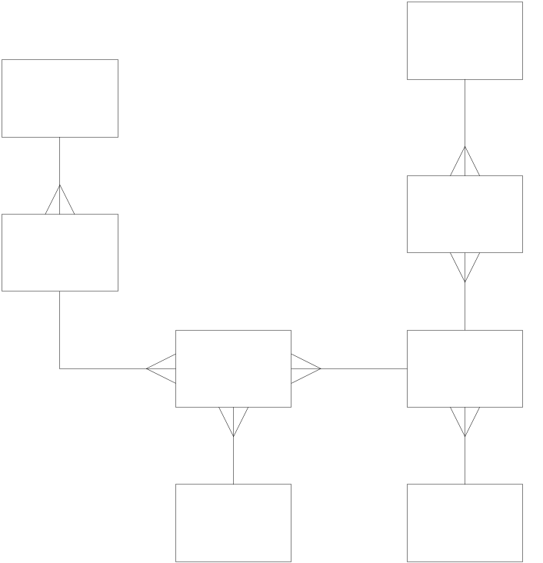
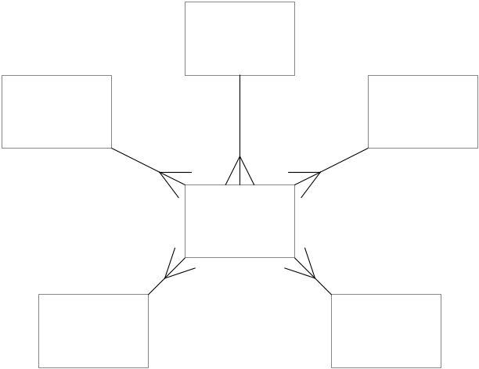
Design Differences
Operational System
Data Warehouse
ER Diagram
Star Schema

Slide 14

Supporting a Complete Solution
Operational System-
Data Entry
Data Warehouse-
Data Retrieval

Slide 15
Data Warehouses, Data Marts, and Operational Data Stores
Data Warehouse – The queryable source of data in the enterprise. It is comprised of the union of all of its constituent data marts.
Data Mart – A logical subset of the complete data warehouse. Often viewed as a restriction of the data warehouse to a single business process or to a group of related business processes targeted toward a particular business group.
Operational Data Store (ODS) – A point of integration for operational systems that developed independent of each other. Since an ODS supports day to day operations, it needs to be continually updated.

Slide 16
Building a Data Warehouse

Slide 17
Building a Data Warehouse
Data Warehouse Lifecycle
  Analysis
  Design
  Import data
  Install front-end tools
  Test and deploy

Slide 18
Stage 1: Analysis
  Analysis
  Design
  Import data
  Install front-end tools
  Test and deploy
Identify:
  Target Questions
  Data needs
  Timeliness of data
  Granularity
Create an enterprise-level data dictionary
Dimensional analysis
  Identify facts and dimensions

Slide 19
Stage 2: Design
  Analysis
  Design
  Import data
  Install front-end tools
  Test and deploy
Star schema
Data Transformation
Aggregates
Pre-calculated Values
HW/SW Architecture
Dimensional Modeling

Slide 20
Dimensional Modeling
Fact Table – The primary table in a dimensional model that is meant to contain measurements of the business.
Dimension Table – One of a set of companion tables to a fact table. Most dimension tables contain many textual attributes that are the basis for constraining and grouping within data warehouse queries.

Slide 21
Stage 3: Import Data
  Analysis
  Design
  Import data
  Install front-end tools
  Test and deploy
Identify data sources
Extract the needed data from existing systems to a data staging area
Transform and Clean the data
  Resolve data type conflicts
  Resolve naming and key conflicts
  Remove, correct, or flag bad data
  Conform Dimensions
Load the data into the warehouse

Slide 22
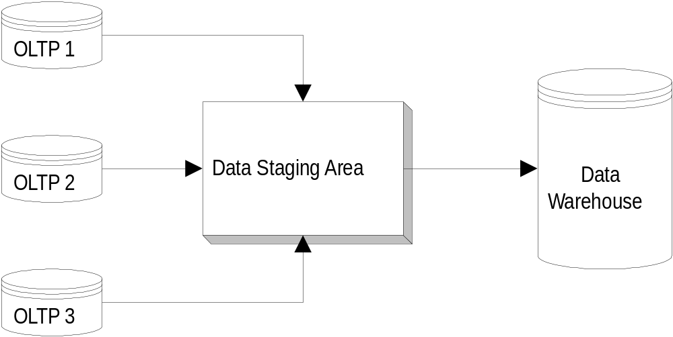
Importing Data Into the Warehouse
Operational Systems
(source systems)

Slide 23

Stage 4: Install Front-end Tools
  Analysis
  Design
  Import data
  Install front-end tools
  Test and deploy
Reporting tools
Data mining tools
GIS
Etc.

Slide 24
Stage 5: Test and Deploy
  Analysis
  Design
  Import data
  Install front-end tools
  Test and deploy
Usability tests
Software installation
User training
Performance tweaking based on usage

Slide 25

Special Concerns
Time and expense
Managing the complexity
Update procedures and maintenance
Changes to source systems over time
Changes to data needs over time

Slide 26

STOrage and RETrieval (STORET)
Improved performance and faster data retrieval
Ability to produce larger reports
Ability to provide more data query options
Streamlined application navigation

Slide 27
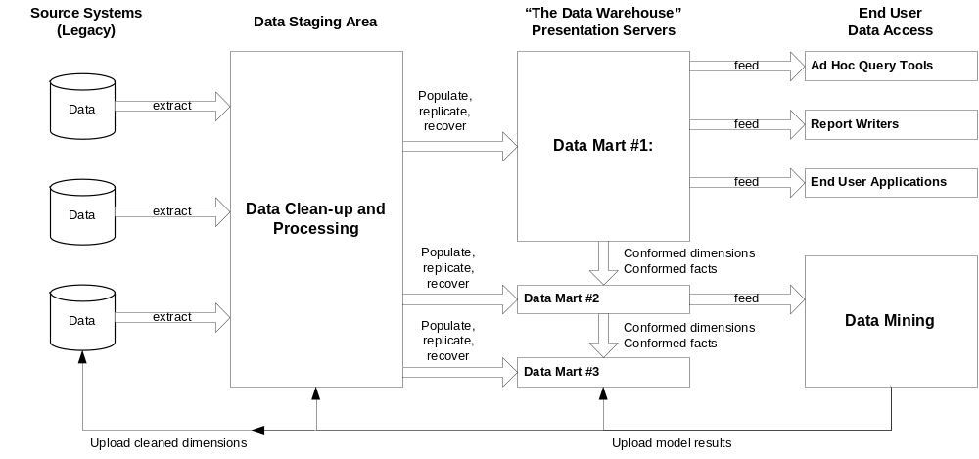
Data Warehouse Components

Slide 28
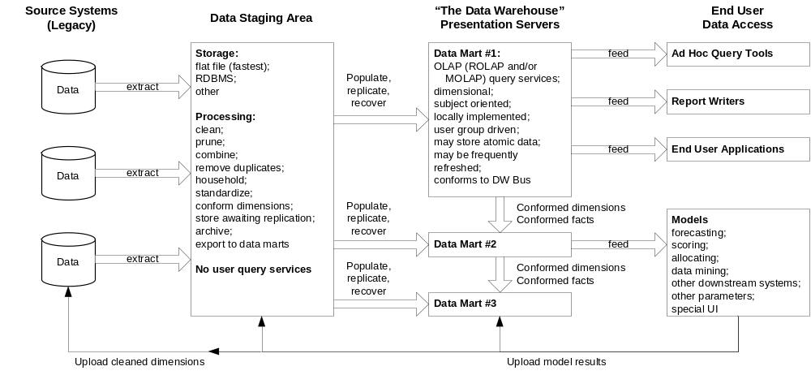
Data Warehouse Components – Detailed

